Slide 1
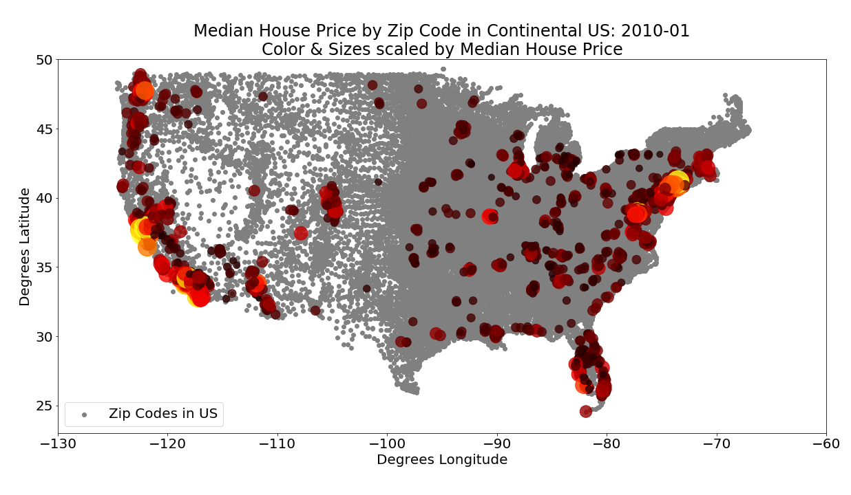
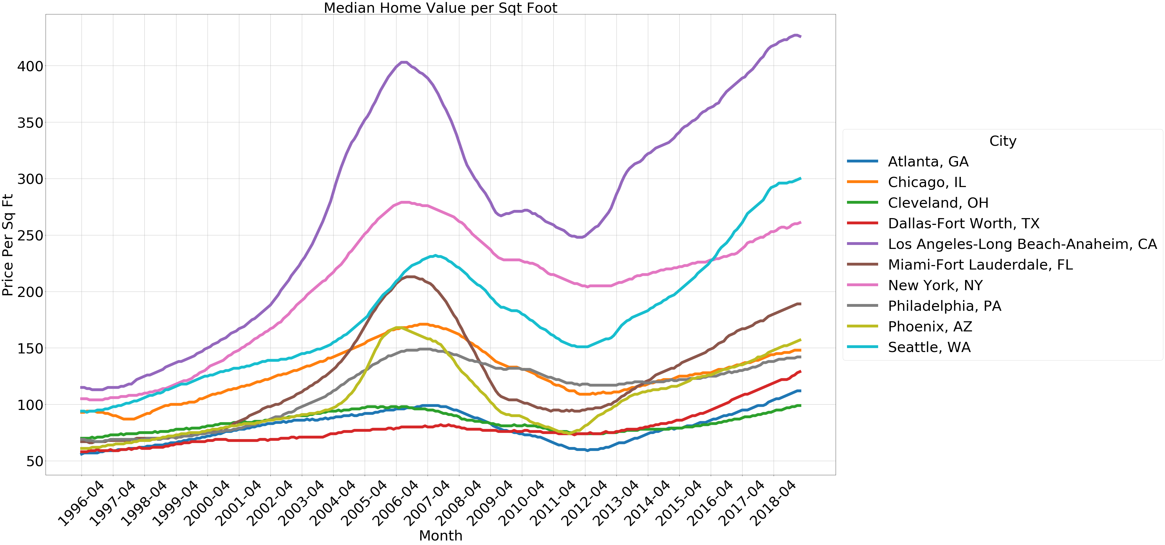
An Analysis of the Factors that Impact Housing Costs in the US
Kim Harrison
Kent Hazen
Tim Tang
Laura De Morneau
9 April 2019

Slide 2
Our approach was to utilize datasets from different sources to determine what factors impact housing prices
Rent or Buy?
Demographics
Severe Weather Events
House Layout
Notes:
How do location demographics impact housing prices? What is the impact of gentrification? (Lead by Kent)
What are the features of the houses & properties that can impact the price of houses? We’ll look specifically at data from LA, Orange, and Ventura counties. (Lead by Kim)
What is the impact of weather and/or environmental factors on housing prices? (Lead by Laura)
What factors impact the decision to rent or buy? (Lead by Tim)

Slide 3
Our approach was to utilize datasets from different sources to determine what factors impact housing prices
Does it make more financial sense to rent or buy in a given city?
How do location demographics impact housing prices?
Rent or Buy?
Demographics
What is the impact of severe weather events on housing prices?
How does the layout of a house impact the price?
Severe Weather Events
House Layout
Notes:
How do location demographics impact housing prices? What is the impact of gentrification? (Lead by Kent)
What are the features of the houses & properties that can impact the price of houses? We’ll look specifically at data from LA, Orange, and Ventura counties. (Lead by Kim)
What is the impact of weather and/or environmental factors on housing prices? (Lead by Laura)
What factors impact the decision to rent or buy? (Lead by Tim)

Slide 4
Our approach was to utilize datasets from different sources to determine what factors impact housing prices
House Prices, Amenities
Demographic, City Info
Severe Weather Events

Slide 5
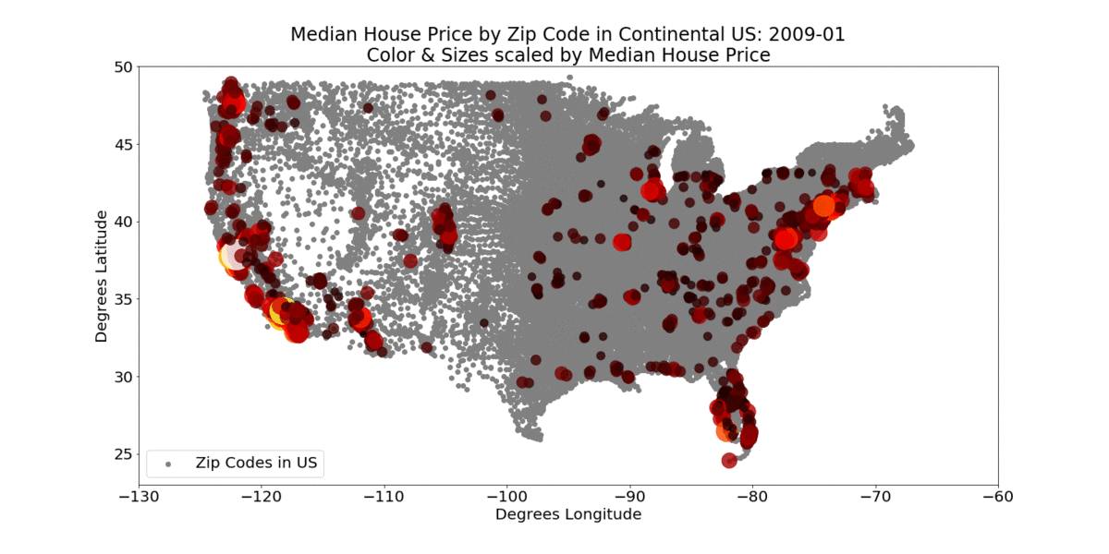
While cleaning our data, we decided to select 10 target cities to analyze housing prices to answer our questions
Seattle
Chicago
Cleveland
New York
Philly
LA
Atlanta
Phoenix
Dallas
Miami
Housing Price Snap Shot every 6 months over the last 10 years

Slide 6

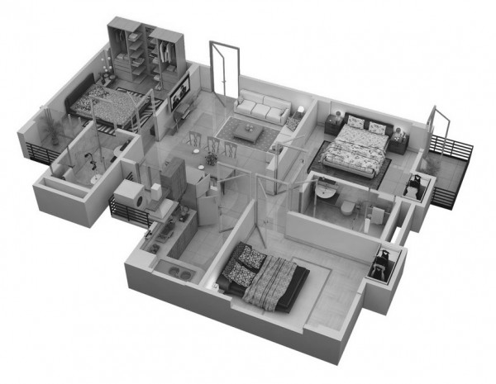

Our approach was to utilize datasets from different sources to determine what factors impact housing prices
Rent or Buy?
Demographics
Severe Weather Events
House Layout
Notes:
How do location demographics impact housing prices? What is the impact of gentrification? (Lead by Kent)
What are the features of the houses & properties that can impact the price of houses? We’ll look specifically at data from LA, Orange, and Ventura counties. (Lead by Kim)
What is the impact of weather and/or environmental factors on housing prices? (Lead by Laura)
What factors impact the decision to rent or buy? (Lead by Tim)

Slide 7
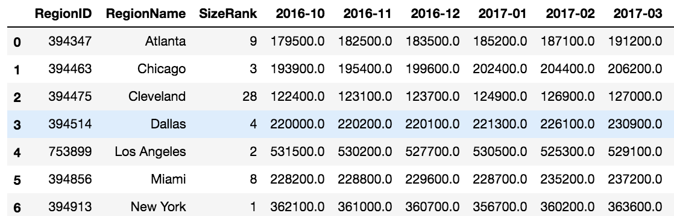
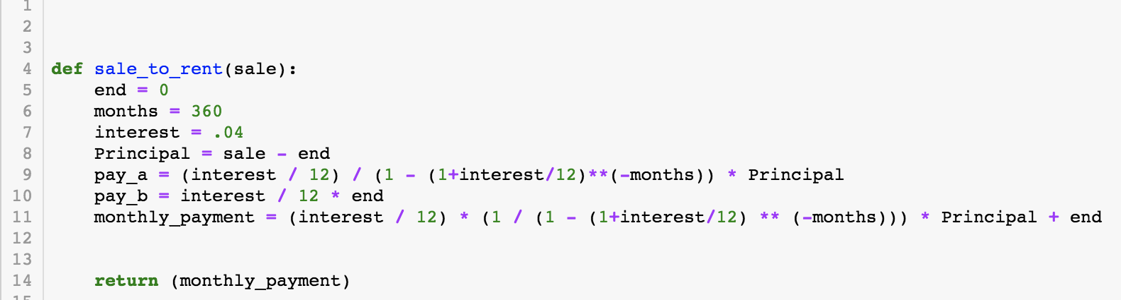
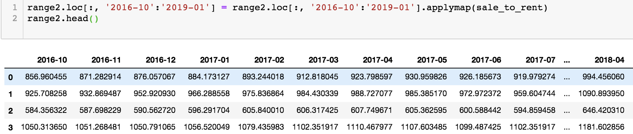
Average house price was converted to mortgage payments using a function to compare buying versus renting
Sales Data Not in Monthly Payment Format
Created a function to convert to monthly payment
Applied the function to each cell

Slide 8
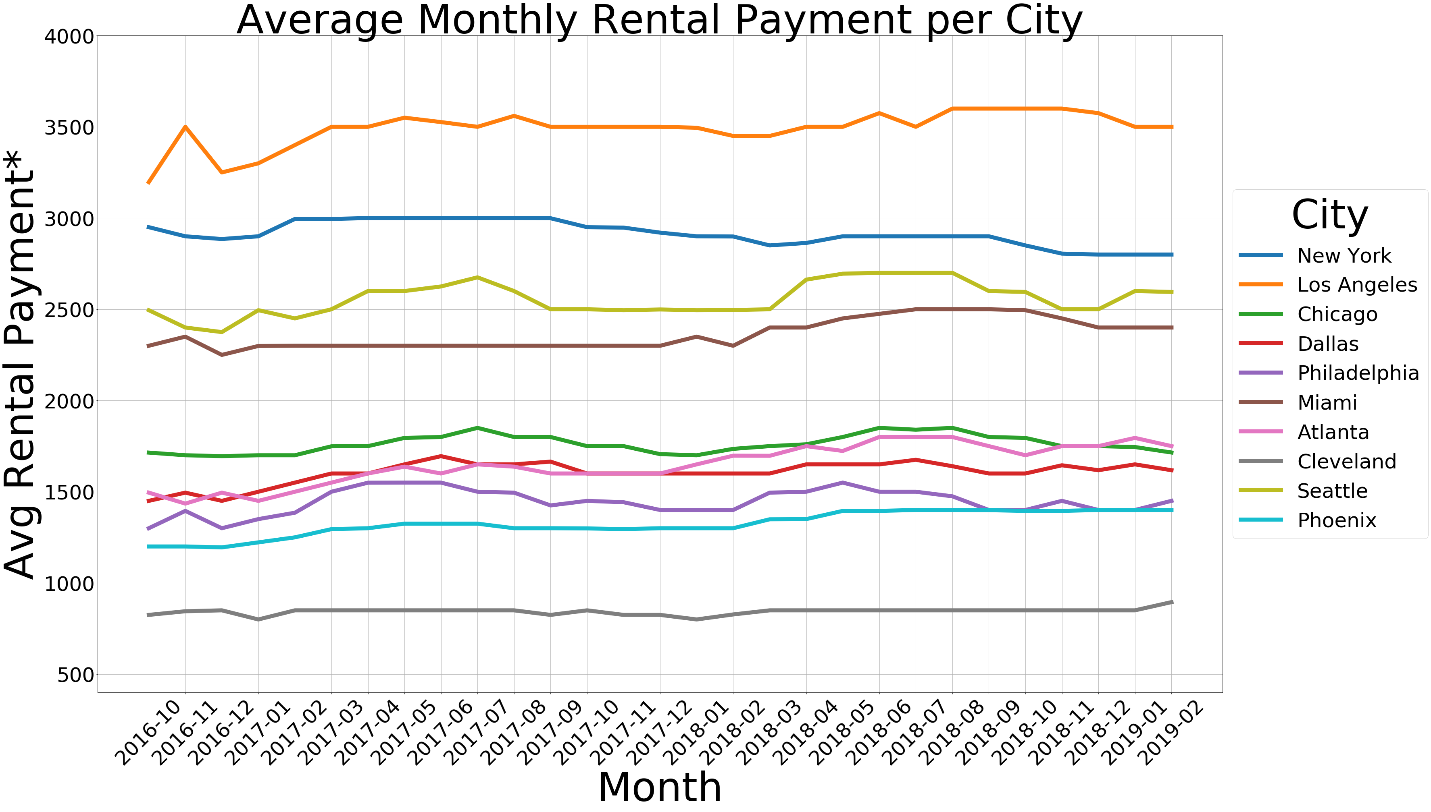
Mortgage payments versus rental payments show if you should buy or rent in a given city

Slide 9
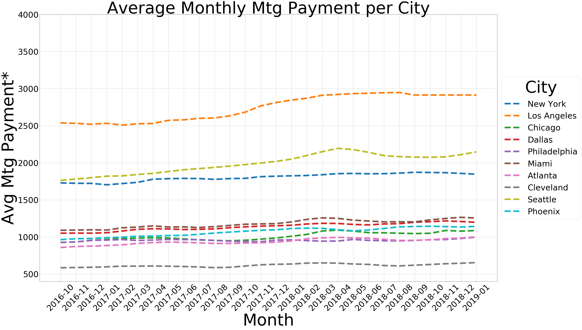
Mortgage payments versus rental payments show if you should buy or rent in a given city

Slide 10
Mortgage payments versus rental payments show if you should buy or rent in a given city
Assumptions:
For Sales Price to Monthly Payment conversion, payments are based on 4% interest rate and 30 year term
Monthly payment comparison does not factor down payment, property taxes, home maintenance
Population used does not reflect rural or suburban area
Used historical average to fill in blank months
Limited Date Range, used from 2016 thru 2019 data only
Notes:
For Sales Price to Monthly Payment conversion, payments are based on 4% interest rate and 30 year term
Monthly payment comparison does not factor down payment, property taxes, home maintenance
Population used does not reflect rural or suburban area

Slide 11
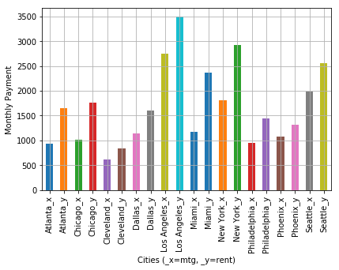
Rental prices verse average mortgages are plotted for the ten target cities

Slide 12
Highest Rental Payments
#1 Los Angeles
#2 New York City
Lowest Rental Payments
#1 Cleveland
#2 Phoenix
Highest Mortgage Payments
#1 Los Angeles
#2 Seattle
Lowest Mortgage Payments
#1 Cleveland
#2 Atlanta
Biggest Differences in Payments
#1 Miami
#2 New York

Slide 13

Our approach was to utilize datasets from different sources to determine what factors impact housing prices
Rent or Buy?
Demographics
Severe Weather Events
House Layout
Notes:
How do location demographics impact housing prices? What is the impact of gentrification? (Lead by Kent)
What are the features of the houses & properties that can impact the price of houses? We’ll look specifically at data from LA, Orange, and Ventura counties. (Lead by Kim)
What is the impact of weather and/or environmental factors on housing prices? (Lead by Laura)
What factors impact the decision to rent or buy? (Lead by Tim)

Slide 14
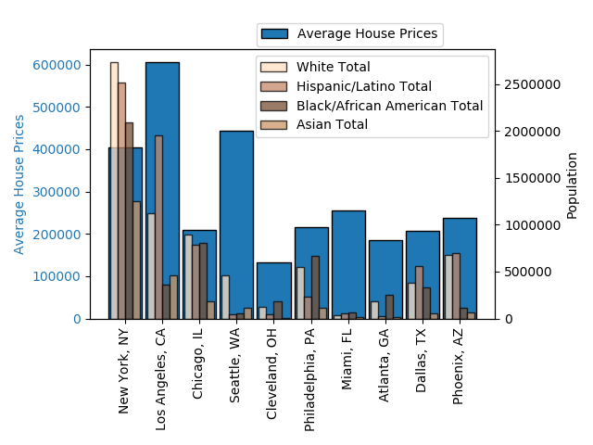
Using a t-test, racial makeup of cities showed no statistical significance on housing prices

Slide 15
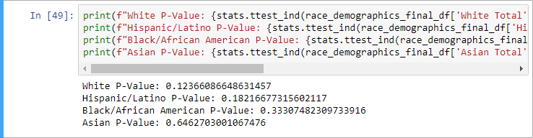
Using a t-test, racial makeup of cities showed no statistical significance on housing prices

Slide 16
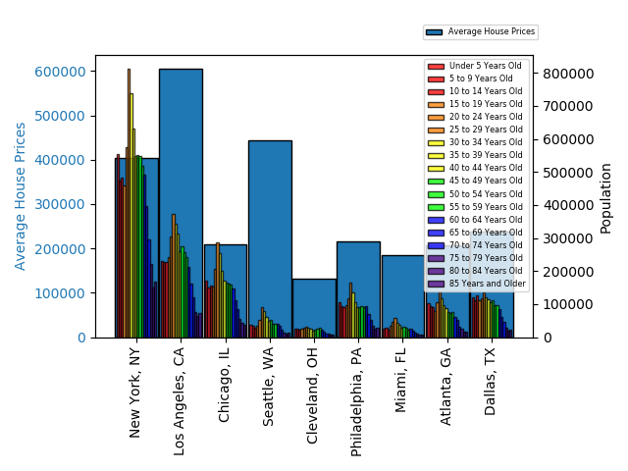
Using a t-test, age was shown to have a statistical significance on housing prices

Slide 17
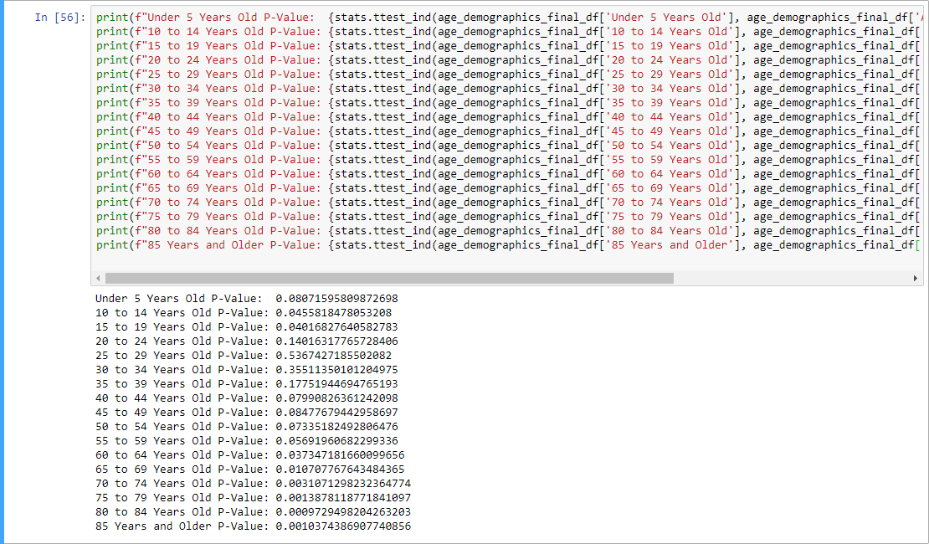
Using a t-test, age was shown to have a statistical significance on housing prices

Slide 18

Using a t-test, age was shown to have a statistical significance on housing prices

Slide 19
Our approach was to utilize datasets from different sources to determine what factors impact housing prices
Rent or Buy?
Demographics
Severe Weather Events
House Layout
Notes:
How do location demographics impact housing prices? What is the impact of gentrification? (Lead by Kent)
What are the features of the houses & properties that can impact the price of houses? We’ll look specifically at data from LA, Orange, and Ventura counties. (Lead by Kim)
What is the impact of weather and/or environmental factors on housing prices? (Lead by Laura)
What factors impact the decision to rent or buy? (Lead by Tim)

Slide 20
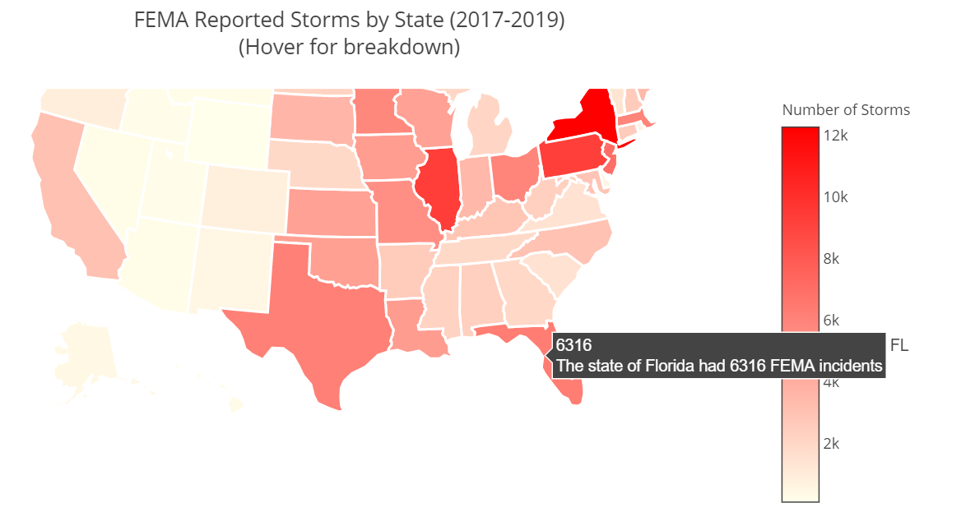
FEMA data was analyzed to calculate the number of severe weather events by location

Slide 21
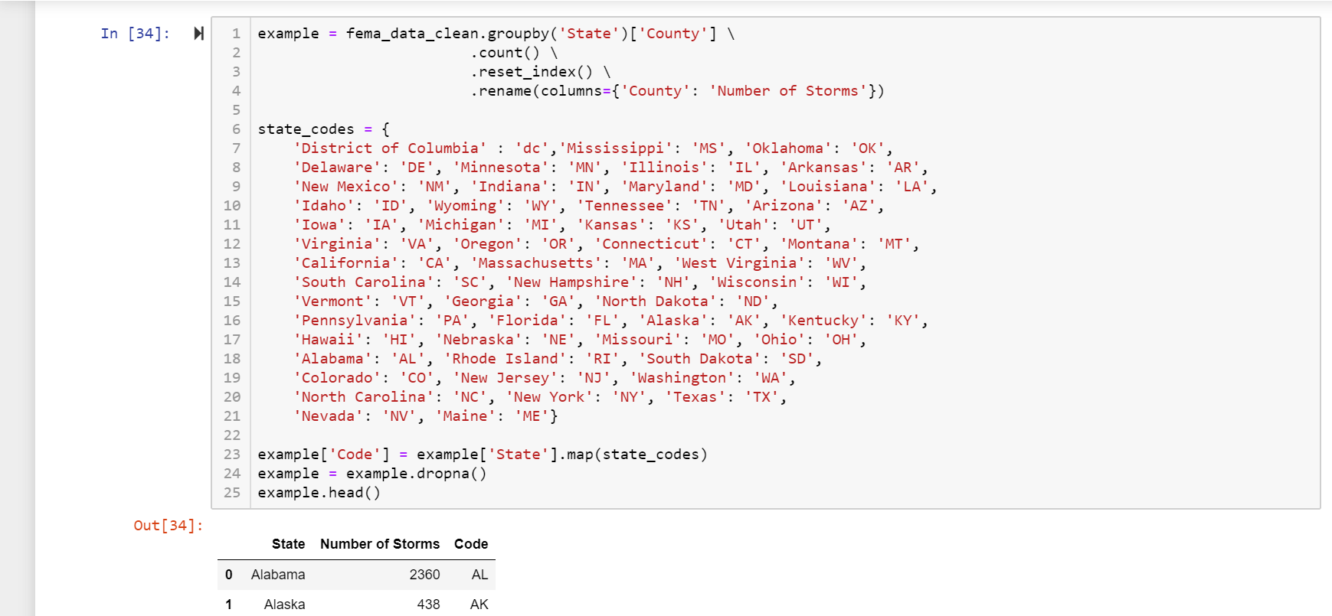
FEMA data was analyzed to calculate the number of severe weather events by location

Slide 22
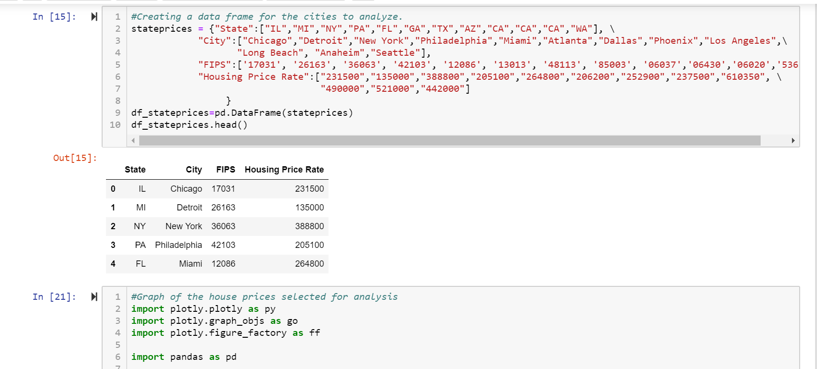
FEMA data was analyzed to calculate the number of severe weather events by location

Slide 23
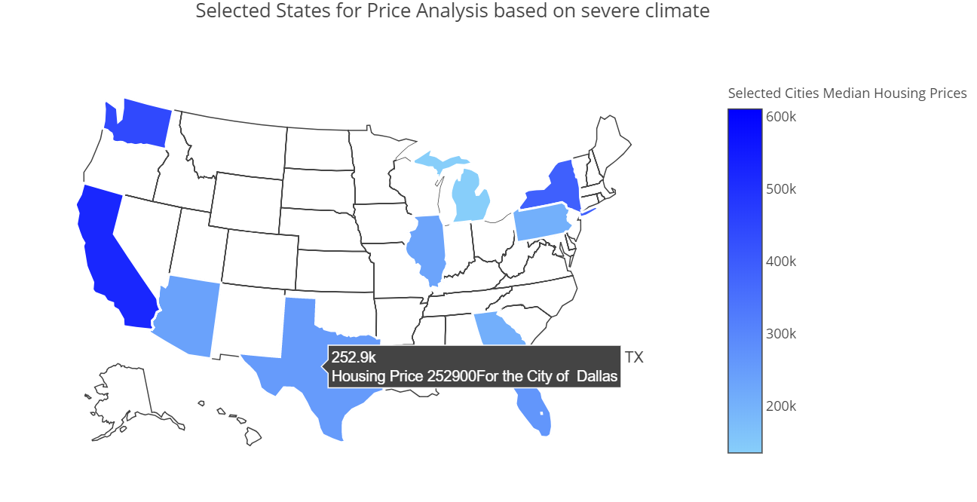
FEMA data was analyzed to calculate the number of severe weather events by location

Slide 24
Our approach was to utilize datasets from different sources to determine what factors impact housing prices
Rent or Buy?
Demographics
Severe Weather Events
House Layout
Notes:
How do location demographics impact housing prices? What is the impact of gentrification? (Lead by Kent)
What are the features of the houses & properties that can impact the price of houses? We’ll look specifically at data from LA, Orange, and Ventura counties. (Lead by Kim)
What is the impact of weather and/or environmental factors on housing prices? (Lead by Laura)
What factors impact the decision to rent or buy? (Lead by Tim)

Slide 25
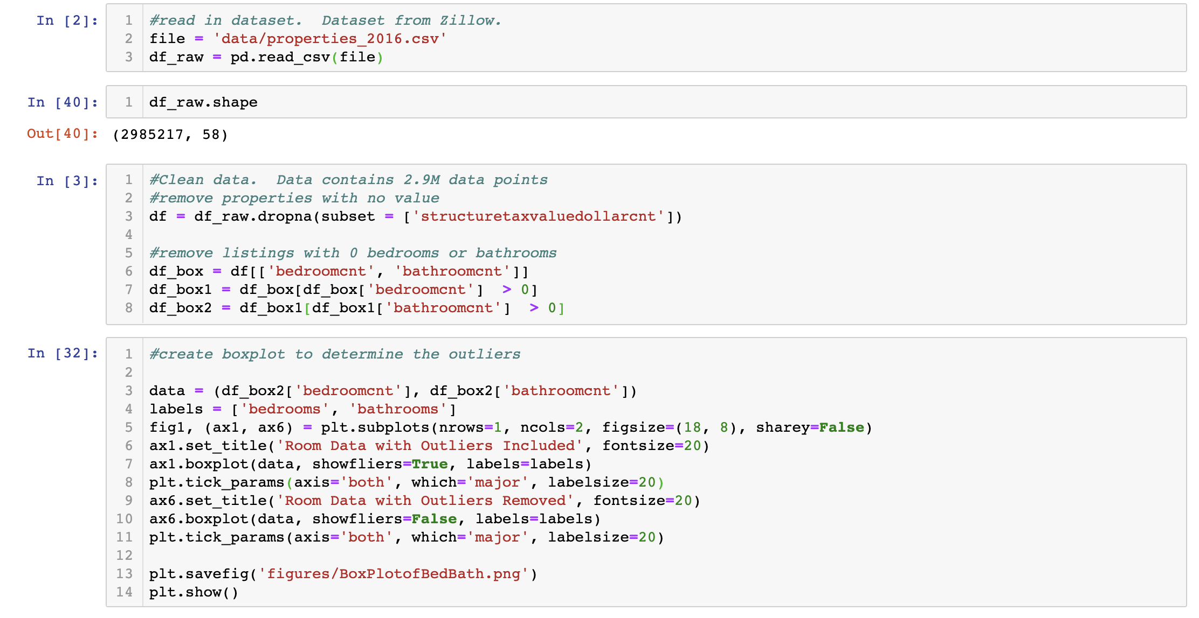
Layout data was analyzed for 2.9 million housing properties in 2016 for LA, Ventura, and Orange County
2.98M data points, 58 columns
Removed datasets with 0 values in bed and bath

Slide 26
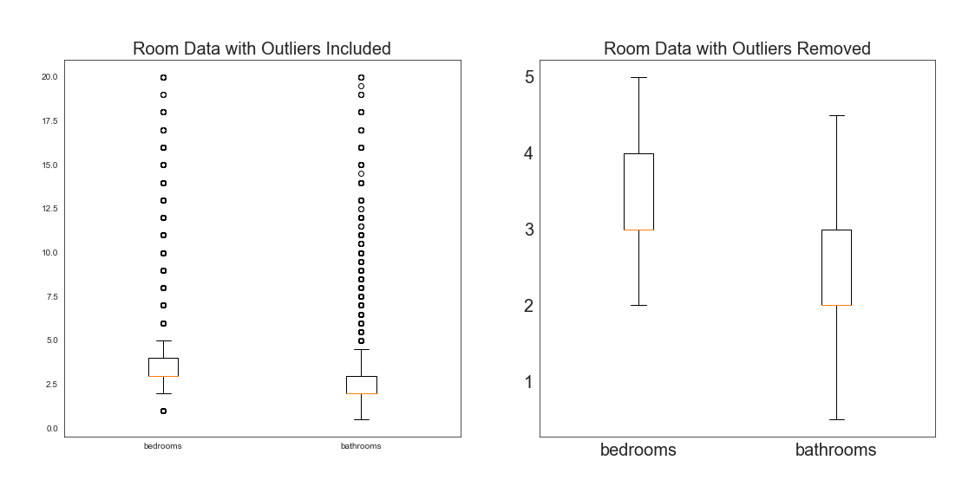
Layout data was analyzed for 2.9 million housing properties in 2016 for LA, Ventura, and Orange County
Data cleanup showed many outliers that needed to be filtered

Slide 27
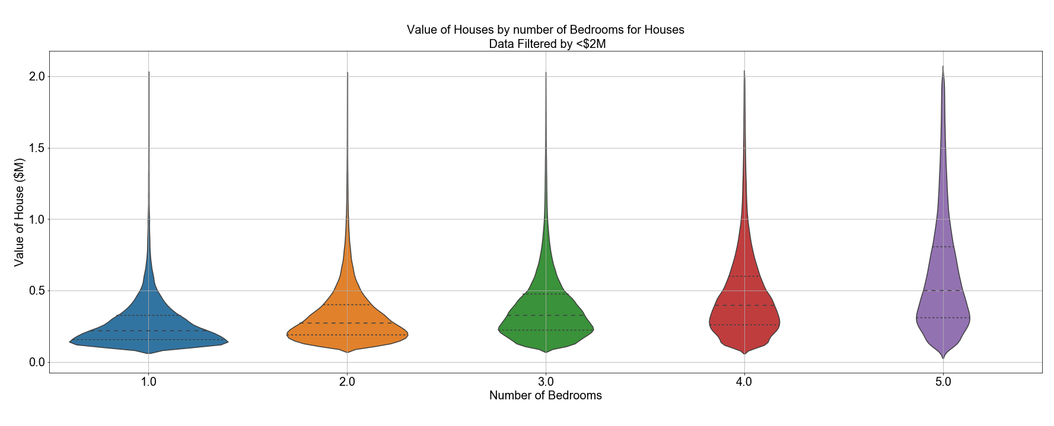
In general, as the number of bedrooms increased, the average house value increased
Avg:
$271,563
$332,724
$388,880
$475,325
$613,218
Increase:
+$61,161
+$56,156
+$86,445
+$137,893

Slide 28
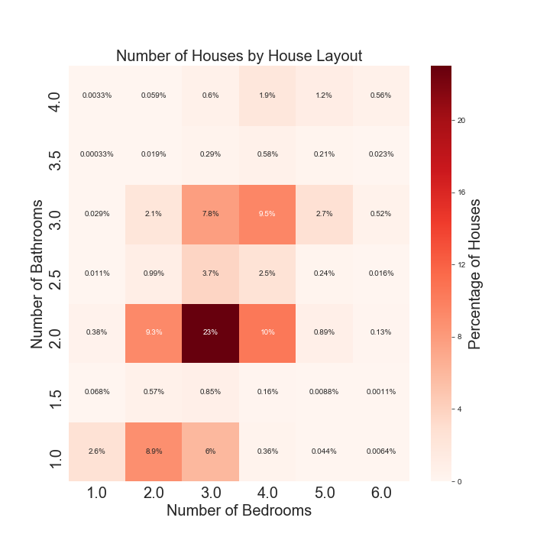
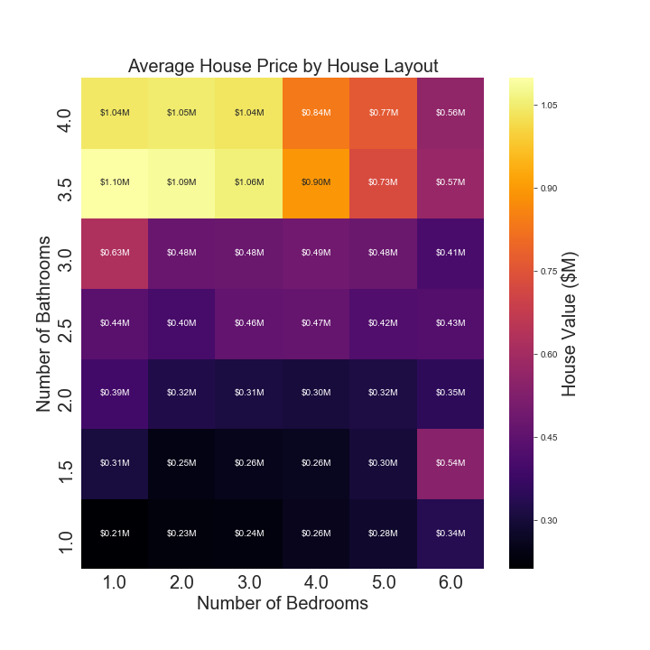
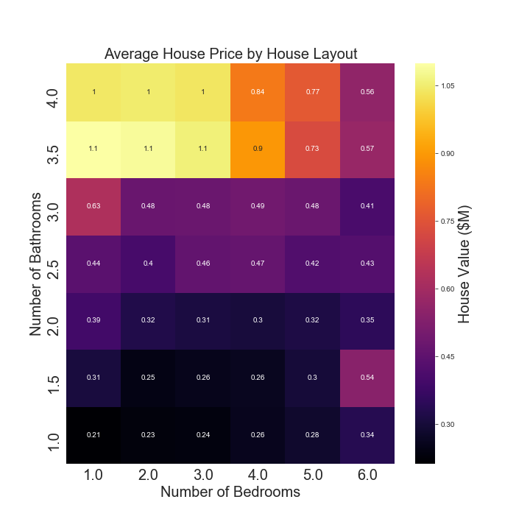
Heatmaps were used to show the most common layouts, as well as the average price per layout

Slide 29
Heatmaps were used to show the most common layouts, as well as the average price per layout

Slide 30
Heatmaps were used to show the most common layouts, as well as the average price per layout
4BR, 3BA: $490,000
3BR, 2BA: $310,000

Slide 31
In summary, demographics, severe weather events, rental markets, and housing layouts can all impact housing costs
In most cities, it makes more financial sense to buy vs. rent
Racial make up did not have an impact on housing, but ages did
Severe weather events did not directly impact housing prices
Heatmaps can be used to show how much value a bedroom or half-bath adds to a house

Slide 32
If given more time, we would look at the following factors to further answer our questions
Look at extreme temperatures; analyze potential development areas and where would be a good place to buy
Go back and look at t-tests on entire list of cities, rather than subset
Demographics
Severe Weather
Look more into historical trends of rentals; get better data sets for mortgage rates
Look at how square footage factors into layouts; examine other house amenities
Rent vs. Buy?
House Layout

Slide 33
BACK UP SLIDES

Slide 34
The historical look at $/sqft shows the housing market crash and start of the recession in 2008

Slide 35
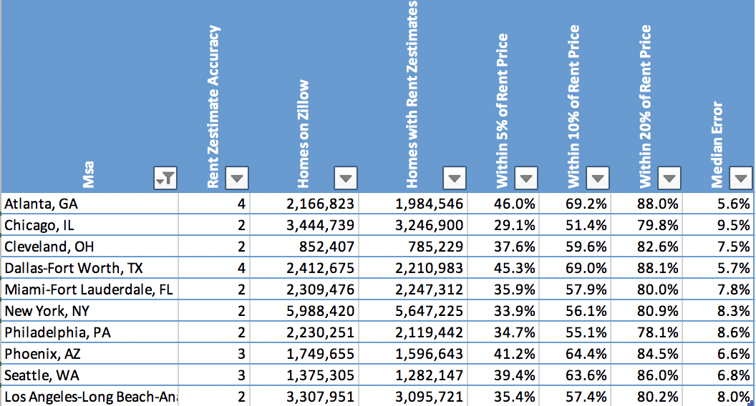
Biases for Rent or Buy
What is a Rent Zestimate?
A Rent Zestimate (pronounced ZEST-ti-met, rhymes with estimate) is Zillow’s estimated monthly rent price, computed using a proprietary formula. It is a starting point in determining the monthly rental price for a specific property. The Rent Zestimate is pulled from public property data and similar local properties listed for rent; there may be special features, location, and market conditions our algorithms have not taken into account. Variations in rental price can also occur because of negotiating factors, special incentives, and length of lease.

